Slide 1
The Instant Dysphagia Kitchen You’ve Had the Diagnosis of a Swallow Disorder Managing the Change
How to Set Up A Modified Texture Food Station In the Home Kitchen
Appliances and Tools
The Best Techniques

Slide 2
Why I Wrote Cooking For Dysphagia Mayo Clinic Press Publication Date Fall 2025
48 million people are in home healthcare in the U. S., according to Amy Goyer, the moderator of the AARP Family Caregiving Support Group on Facebook.
According to Mayo Clinic Online, up to 30 per cent of those in home healthcare have a swallowing disorder.
Food is Medicine, Food is Love. The role of good nutrition in preventive medicine has been acknowledged by the Harvard Chan School of Public Health, Healthy Eating Plate, especially in the time of the pandemic.

Slide 3
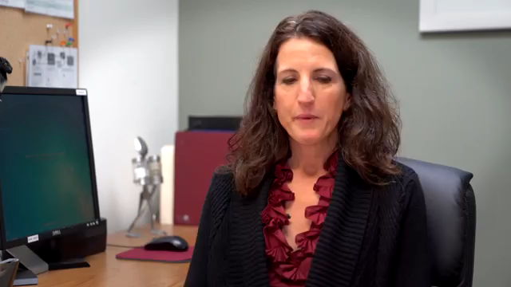
The Diagnosis Cooking for Dysphagia and Other Swallowing Disorders: 101 Delicious Recipes and Techniques for Safe Easy Eating is the guidebook for the transformation of your kitchen to a dysphagia kitchen. The loved one with a swallow disorder has a prescribed IDDSI Level. Every meal must be IDDSI-compliant. This means Texture Modified and tested with the spoon tilt and fork test.. The transition may create a tizzy in a household. Here’s how to manage with ease.

Slide 4

“Deliciousness Matters” It boosts the immune system. It makes a person feel cared for. It improves the mood.
Diane is the author of The Cooking for Dysphagia: 101 Delicious Recipes for Safe Easy Eating.
This is manual is a step-by-step guide to the transition to a kitchen for modified texture foods that are created to IDDSI standards.
The single most important way that a person can improve health, quality of life, and the immune system is with good nutrition.
The book uses the Healthy Eating Plate of The Harvard Chan School of Public Health for an easy to follow model.
It is super easy to adapt.

Slide 5
Why Make Food At Home?
It’s Cheaper.
It’s Better.
You know what’s in it.
Why use Batch Cooking? A good meal is always on hand.
Feed the loved one multiple times with one cooking session OR feed the loved one and family and friends. Batch Cooking saves labor, time and money.
The primary caregiver is not chained to the kitchen. A backup caregiver or family member can reheat a meal without cooking. It gives the caregiver a break.

Slide 6
The First Thing
Make a list of the Loved One’s Ten Favorite Meals. This is your menu.
Assess your tools. Work with what you have and acquire tools as needed.
Stock your pantry so a quick easy meal may be made any time.
Use Batch Cooking. Cook once and store meals in the freezer.
Mix and Match: Make single servings, protein, carbs and veggies and sauces and store in freezer. The individual eats as desire dictates. This is choice. This is control. Variety means an end to the individual’s boredom. Be sure to include breakfast, desserts and snacks in the list of favorites.

Slide 7
The Pantry
The sauce is the medium of flavor.
The sauce is the secret to deliciousness.
Buy good sauces or make your own OR
Thicken with thickened broth.
Stock your pantry, including the fridge and the freezer.
A good meal is always on hand. This is the secret.
Two methods: Batch Cook or
Cook One Time

Slide 8
The Basics
Appliances and Tools to get started
Set Up the Counter Like a Station in a Professional Kitchen

Slide 9
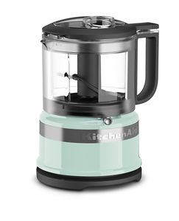
The Mini Food Processor 3.5 Cups

Slide 10
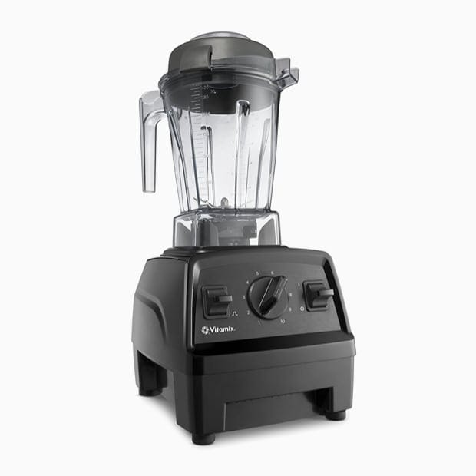
The Blender
Preferably high speed with a heating function for quick soups (a 15-minute meal). This can be a budget model, a standard model or the deluxe model.

Slide 11
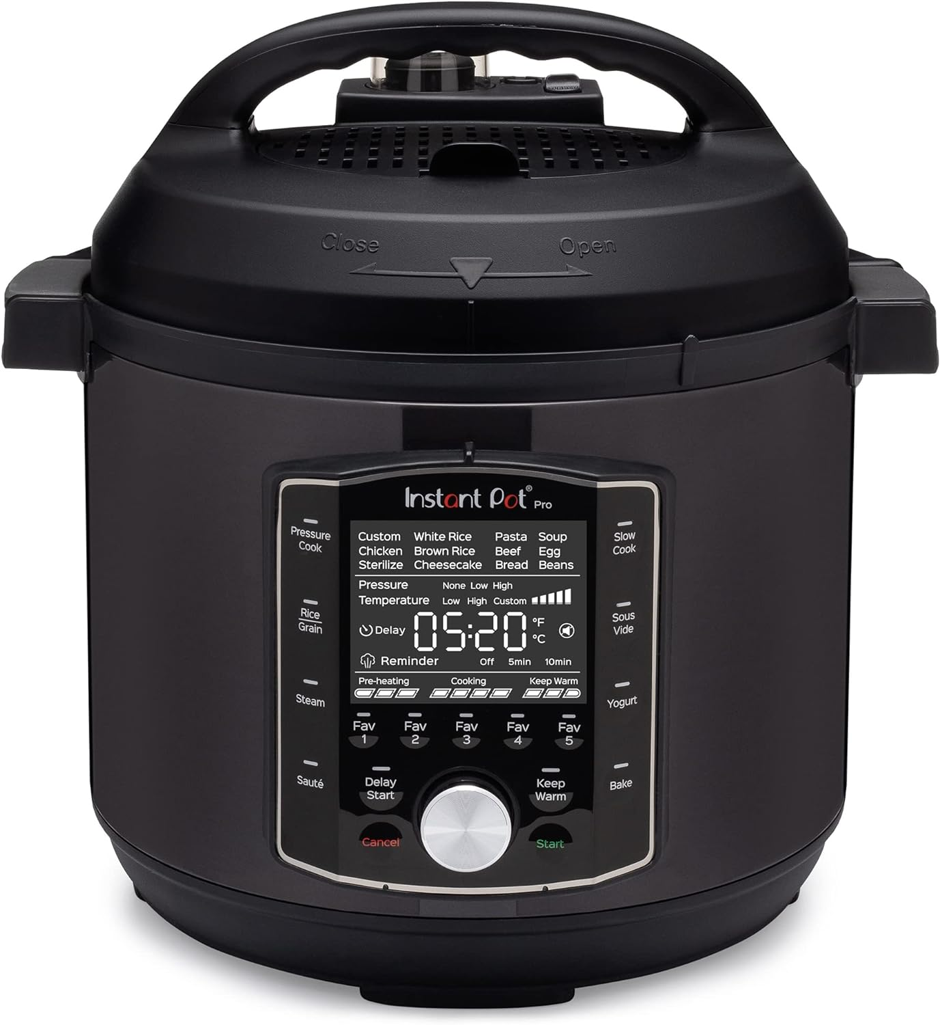
Instant Pot Pro Pressure Cooker, Slow Cooker, Rice/Grain Cooker, Steamer, Sauté, Sous Vide

Slide 12
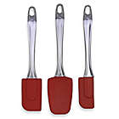
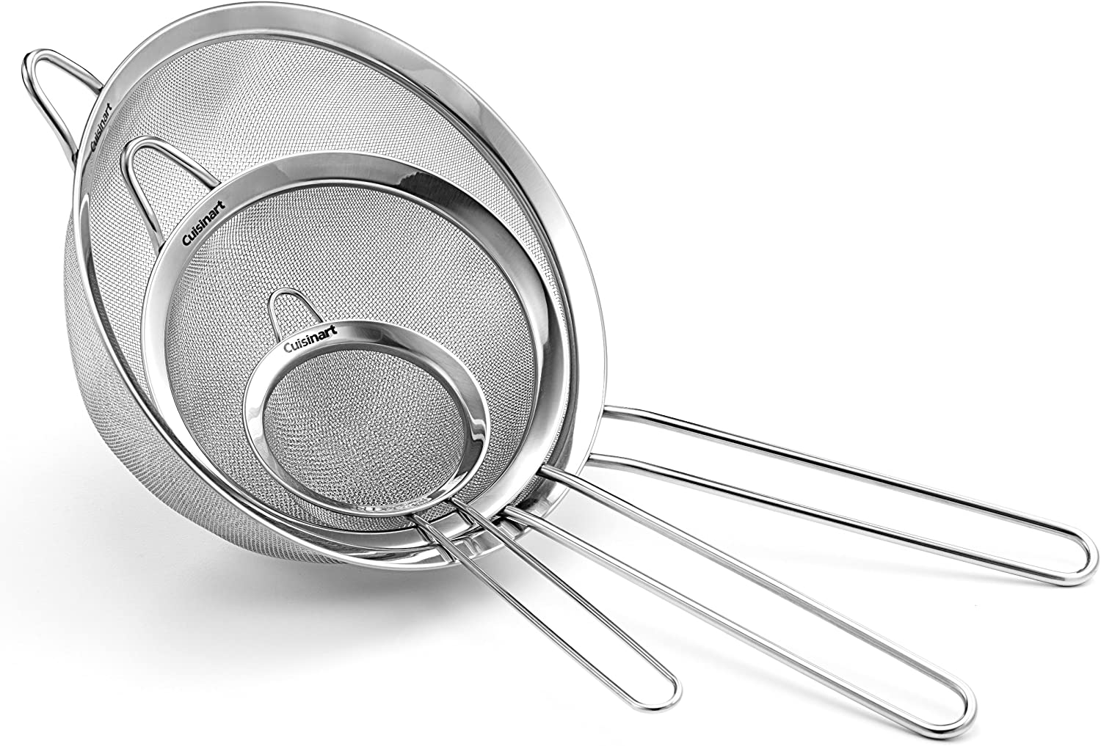
Kitchen Tools Mesh Strainers, Silicone Spatulas, Cheesecloth for tiny seeds like those in strawberries or kiwi

Slide 13
More Tools Available online, and in department stores, discount stores and cookware stores
Stainless Steel Mixing Bowls with lids
Potato Ricer (makes the best mashed potatoes, see recipe)
Microplane Zester and Grater
Vegetable Peeler, straight and y-shaped
Chopping boards, composite or wood
Glass storage containers with lids: oven and dishwasher safe. Buy in sets at the holidays. Single servings.
Whiteboard and sharpie pens
Cheesecloth
Food Mill, for the smoothest texture puree

Slide 14
Cooking For Dysphagia
Technique:
The best techniques for making moist tender food, perfect for texture modified meals:
Braising, as with stews and simmering or boiling as with soups
Steaming, as with vegetables or parcel wraps
Stir fry as in a wok, pressure cooking as in an Instant Pot
Immersion cooking as in sous vide
Regular Kitchen equipment: saucepan, Dutch Oven 6 quarts, cast iron skillet, stock pot
Stainless steel single or multi-tiered steamer
Appliances: Individual appliances, added all at once or one at a time as needed.
* For those who need assistance with dysphagia supplies, contact Dysphagia Outreach
I

Slide 15
Batch Cooking
You make a recipe for six servings. Serve one hot, one goes in fridge for service within 48 hours and freeze 4.
Keep a whiteboard. Keep track of use. Replenish on a schedule.
Store single servings in covered glass dishes in the freezer.
Reheat on the day of service.
A family member or backup caregiver can reheat the meal.

Slide 16

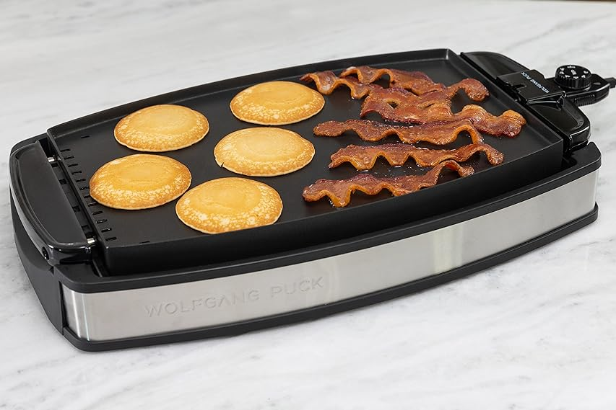
The Indoor Grill
Lower cooking temperature
than an outdoor grill.
No charring, no drying out.
Reversible to a griddle for
Making Pancakes.

Slide 17
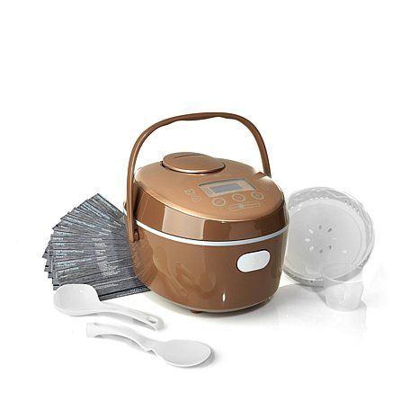
The Multi-Cooker or Slow Cooker With a Steaming Rack Inside

Slide 18
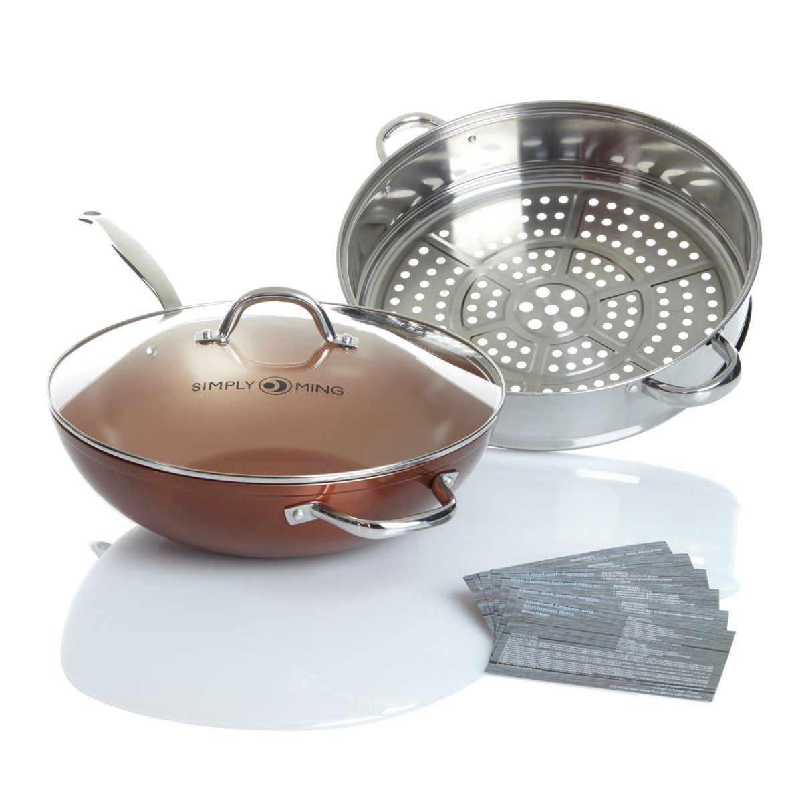
The Wok With Steaming Rack

Slide 19
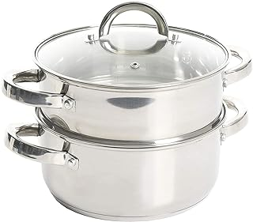
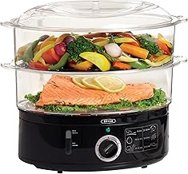
The Multi-Chamber Steamer For Steaming Several Items at Once

Slide 20
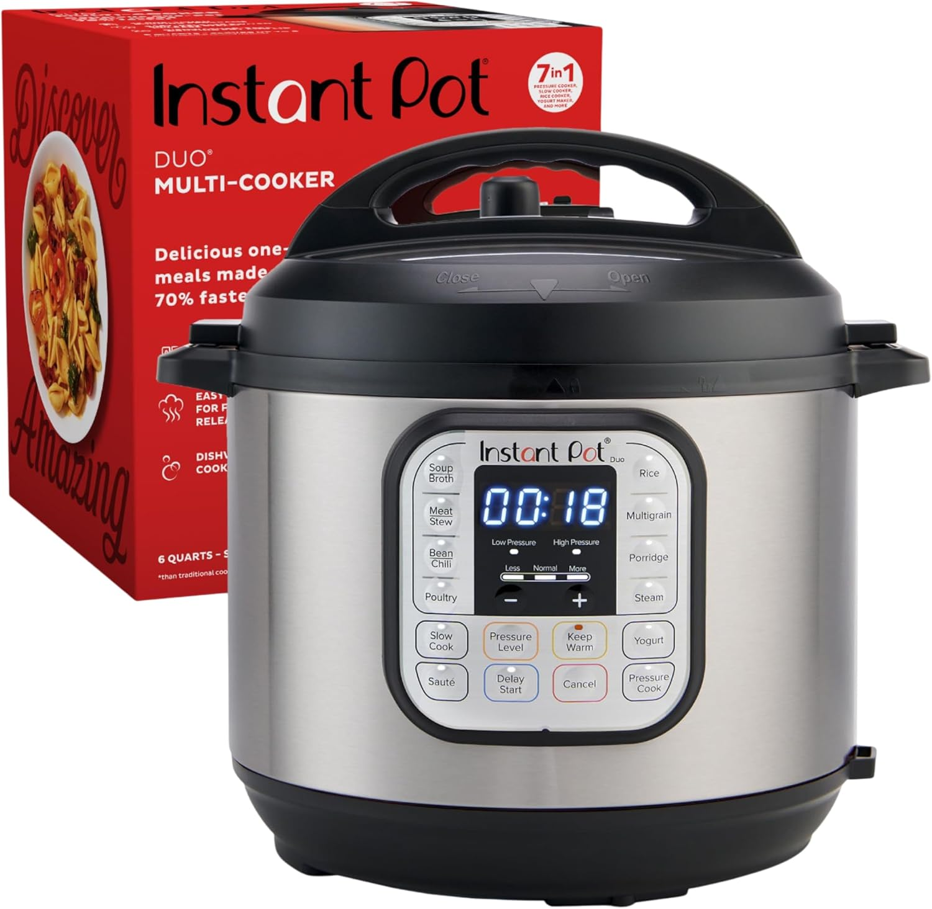
The Instant Pot

Slide 21
We Eat With Our Eyes Secrets from the Japanese Ginza Secrets of Piping from the IDDSI Guy
Secrets I learned as a student of Japanese language studying in Japan for a year. Takeout food in the big department stores of the Ginza. A feast for the eyes and the busy salary man.
Use colorful plates in attractive shapes. Arrange the plates. The atmosphere counts.
Secrets I learned from Andrew Cullum, The IDDSI Guy, premier IDDSI trainer in the UK: How to pipe in shapes. Photo instruction. See Andrew’s chapter in Cooking for Dysphagia and the Resources Section at the back of the book.
Bonus: Revelation: The mystery of piping bread. IDDSI wants all Level 4 bread and pasta to avoid being “sticky”. Sticky sticks in the throat and may cause choking. Here is the link to the method developed by the experts, for sandwiches and wraps.

Slide 22
Food Storage and Labelling
Keep a white board on the outside of the freezer.
Keep track of what you have on hand, and you know what to cook.
Bonus:
A family member or an aide can steam and serve a dish. Even if they can’t cook. The caregiver gets a night off.

Slide 23
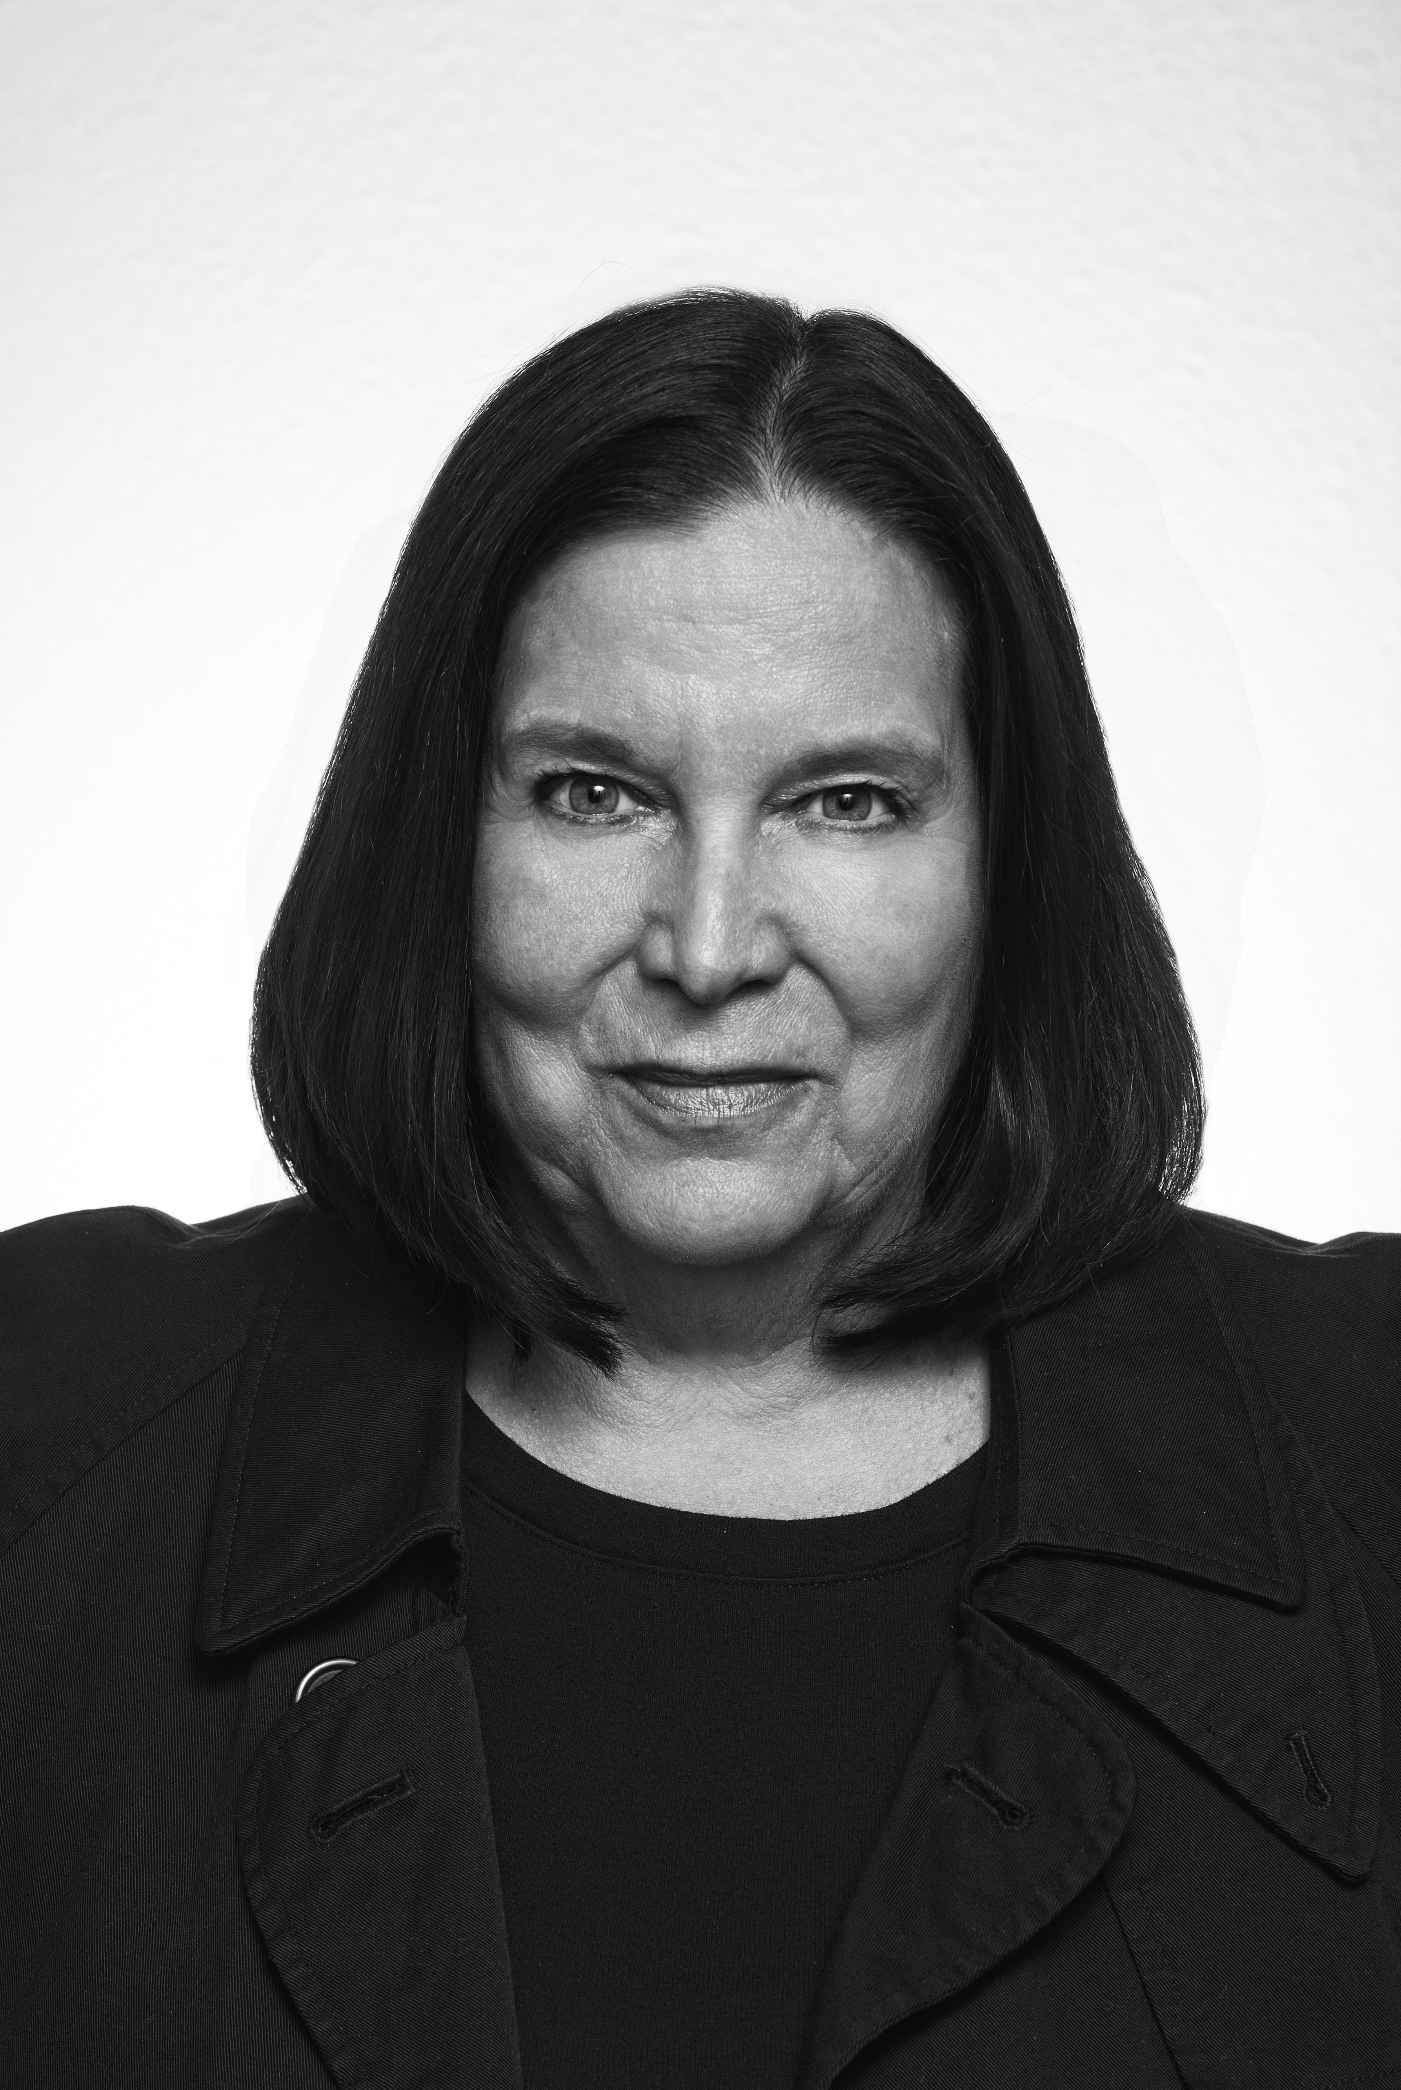
Diane Wolff Author, Cooking for Dysphagia and Other Swallowing Disorders: 101 Delicious Recipes and Techniques for Safe Easy Eating I do this work in memory of my mother, the late great Cathie G, that what I created for her may be of benefit to others. diane@cookingfordysphagia.com .

Slide 24
Further Instruction
For classes, Transforming Your Kitchen and The 5-5-5 Solution
For coaching and cooking instruction for a household
www.cookingfordysphagia.com
diane@cookingfordysphagia.com
To order a copy of the book, go to Amazon or Barnes and Noble..

